Slide 1
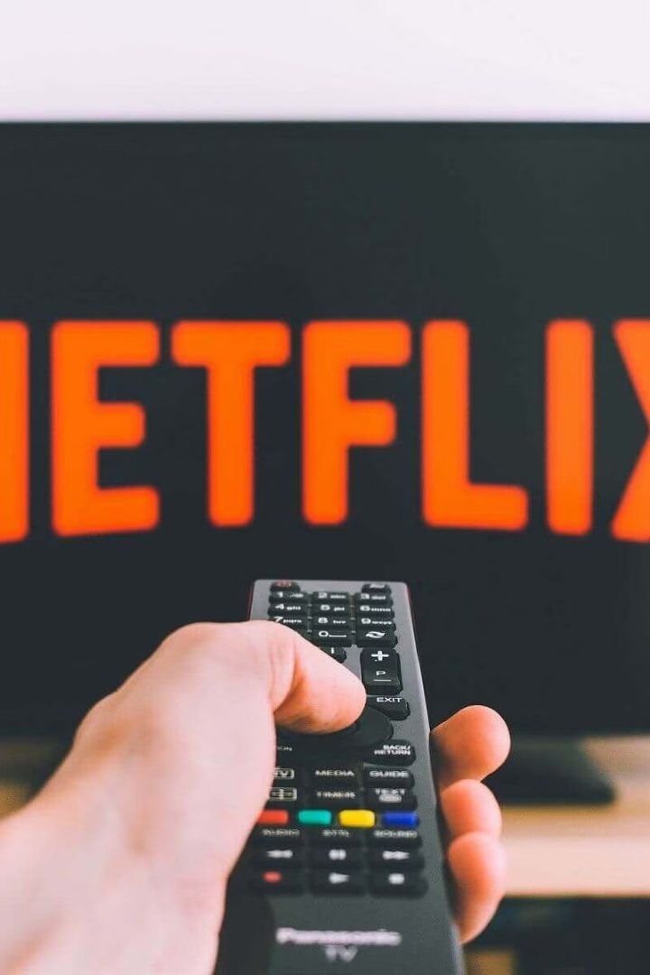

Netflix's Streaming Architecture
Netflix is a global streaming giant that delivers high-quality video content to millions of users worldwide. To achieve this, they rely on a robust and scalable architecture.
by Ram N Java

Slide 2
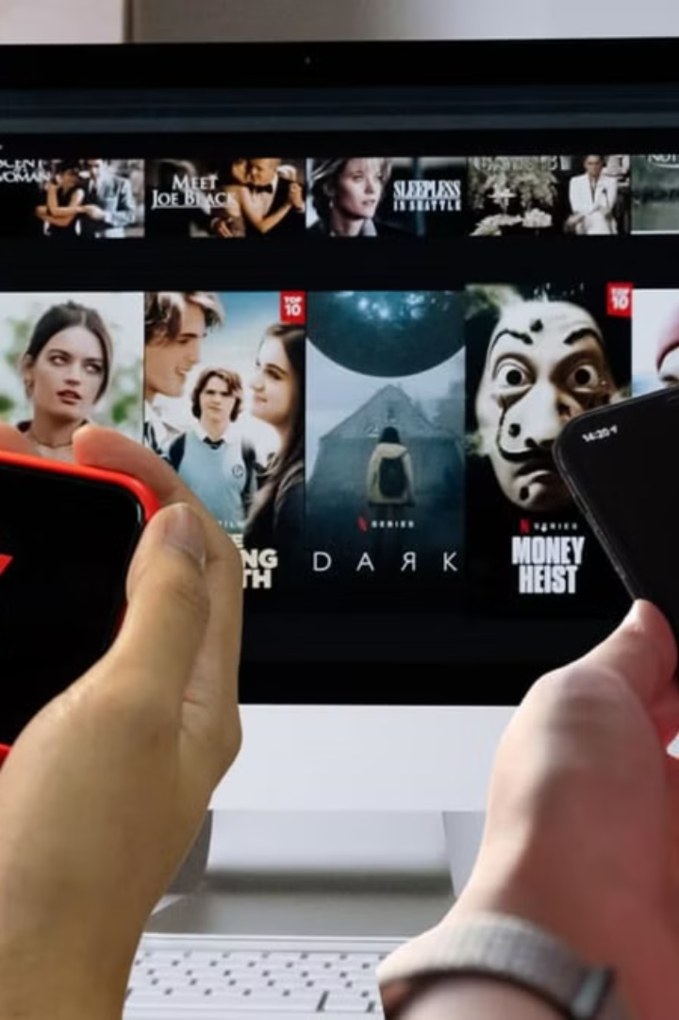




Client Interaction
TV
Smartphone
Laptop
Game Console
This is where you interact with Netflix – your TV, smartphone, laptop, or game console.
The client sends requests to the Netflix servers for things like browsing titles, playing videos, and managing your account.

Slide 3
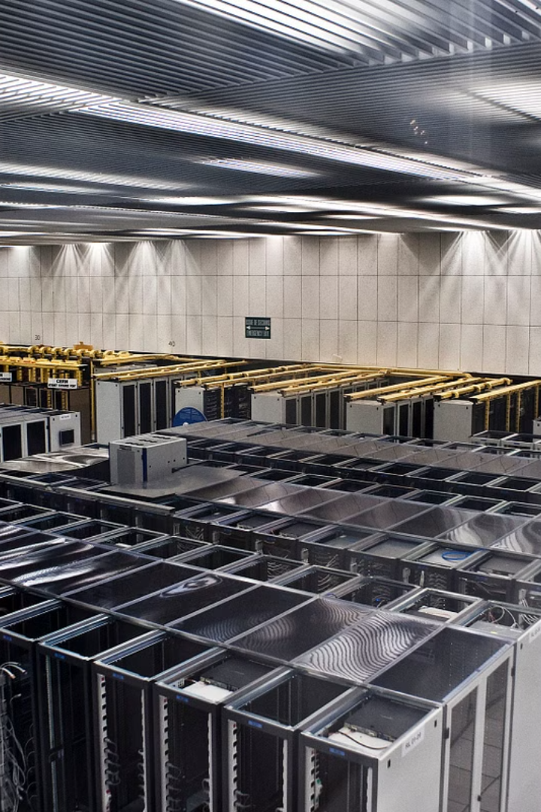
Netflix Backend
This is the "brain" of Netflix, running on Amazon Web Services (AWS).
It handles tasks like:
Personalization
Content Management
Recommending shows and movies based on your viewing history.
Adding new titles, managing metadata (descriptions, actors, etc.), and preparing videos for streaming.
User Management
Traffic Management
Handling subscriptions, payments, and account information.
Directing traffic to the nearest server for faster delivery.

Slide 4

Content Delivery Network (CDN)
Global Network
Open Connect
This is a vast network of servers strategically placed around the globe.
Netflix uses its own CDN called Open Connect.
Faster Streaming
It stores copies of videos closer to users, allowing for faster streaming speeds and reduced buffering.

Slide 5
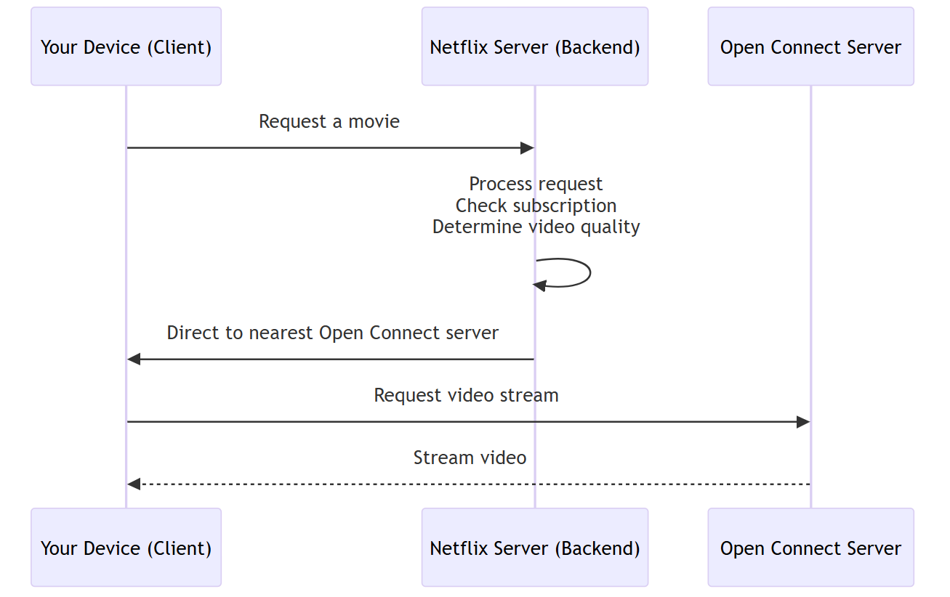
How Netflix Streaming Works

Slide 6





How Netflix Streaming Works
Request
You use your device (client) to request a movie on Netflix.
Processing
The request travels to the nearest Netflix server (backend).
Verification
The server processes the request, checks your subscription, and determines the
best video quality for your internet speed.
Direction
The server directs your device to the nearest Open Connect server that has the requested video.
Streaming
The video starts streaming directly from the Open Connect server to your device.

Slide 7

Key Concepts of Netflix Architecture
Microservices
Scalability
Fault Tolerance
Netflix's backend is divided into many small, independent services. This makes the system more flexible and easier to scale.
Netflix's architecture can handle massive traffic spikes, such as during popular show releases.
If one part of the system fails, other parts can continue to function, minimizing disruptions for users.

Slide 8
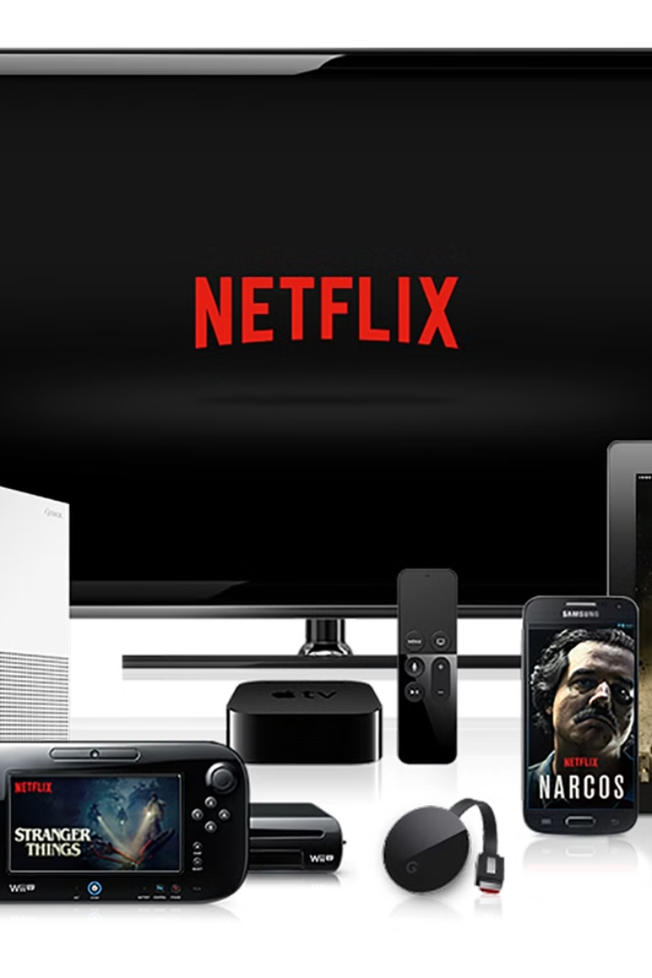
Netflix's Efficient Streaming System
In essence, Netflix's architecture is a complex but efficient system designed to deliver a seamless streaming experience to millions of users worldwide.

